Slide 1

CUSTOMER CARE RESGISTRY
DATA FLOW DIAGRAM
TEAM DETAILS
Team No : PNT2022TMID06554
College Name : Erode Sengunthar Engineering College
Department : B.Tech Information Technology
Team Members: M. Anitha , M. Arunkumar , P. Santhosh , A. Venkatesan

Slide 2
Date | 03 October 2022
Team ID | PNT2022TMID06554
Project Name | Project – Customer Care Registry
Maximum Marks | 4 Marks
Data Flow Diagrams:
A Data Flow Diagram (DFD) is a traditional visual representation of the information flows within a system. A neat and clear DFD can depict the right
amount of the system requirement graphically. It shows how data enters and leaves the system, what changes the information, and where data is
stored.

Slide 3
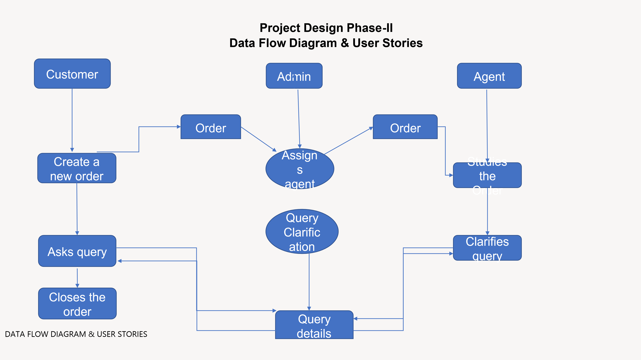

Slide 4
User Stories Use the below template to list all the user stories for the product.
User Type | Functional Requirement (Epic) | User Story Number | User Story / Task | Acceptancecriteria | Priority | Release
Customer (Mobile user) | Registration | USN-1 | As a customer, I can register for the application by entering my email, password, and confirming my password. | I can access my account / dashboard | High | Sprint-1
 | login | USN-2 | As a customer, I can login to the application by entering correct email and password. | I can access my account/dashboard. | High | Sprint-1
 | Dashboard | USN-3 | As a customer, I can see all the orders raised by me. | I get all the info needed in my dashboard. | Low | Sprint-2
 | Order creation | USN-4 | As a customer, I can place my order with the detailed description of my query | I can ask my query | Medium | Sprint-2
 | Address Column | USN-5 | As a customer, I can have conversations with the assigned agent and get my queries clarified | My queries are clarified. | High | Sprint-3
 | Forgot password | USN-6 | As a customer, I can reset my password by this option incase I forgot my old password. | I get access to my account again | Medium | Sprint-4
 | Order details | USN-7 | As a Customer ,I can see the current stats of order. | I get abetter understanding | Medium | Sprint-4
Agent (web user) | Login | USN-1 | As an agent I can login to the application by entering Correct email and password. | I can access my account / dashboard. | High | Sprint-3
 | Dashboard | USN-2 | As an agent, I can see the order details assigned to me by admin. | I can see the tickets to which I could answer. | High | Sprint-3
 | Address column | USN-3 | As an agent, I get to have conversations with the customer and clear his/er dobuts | I can clarify the issues. | High | Sprint-3
 | Forgot password | USN-4 | As an agent I can reset my password by this option in case I forgot my old password. | I get access to my account again. | Medium | Sprint-4

Slide 5
DATA FLOW DIAGRAM & USER STORIES
Admin (Mobile user) | Login | USN-1 | As a admin, I can login to the appliaction by entering Correct email and password | I can access my account/dashboard | High | Sprint-1
 | Dashboard | USN-2 | As an admin I can see all the orders raised in the entire system and lot more | I can assign agents by seeing those order. | High | Sprint-1
 | Agent creation | USN-3 | As an admin I can create an agent for clarifying the customers queries | I can create agents. | High | Sprint-2
 | Assignment agent | USN-4 | As an admin I can assign an agent for each order created by the customer. | Enable agent to clarify the queries. | High | Sprint-1
 | Forgot password | USN-5 | As an admin I can reset my password by this option in case I forgot my old password. | I get access to my account. | High | Sprint-1

Slide 6
THANK YOU!!

